Slide 1
Parallelism-Aware Channel Partition for Read/Write Interference Mitigation in Solid-State Drives
Hyun Jo Lim, Dongkun Shin and Tae Hee Han
Published: 6 December 2022
https://doi.org/10.3390/electronics11234048

Slide 2
Outline
Abstract
Parallelism-Aware-Channel-Partition (PACP)
Evaluation
conclusion

Slide 3
Abstract(1/2)
To improve inefficient utilization of parallel flash memory resources, the PACP method is proposed to prevent SSD performance degradation caused by R/W interference in FTL.
An additional performance improvement is using leveraged garbage collection (GC) migration.
PACP reduced the average read latency by 11.6% and average write latency by 6.0%, with a negligible storage overhead.

Slide 4
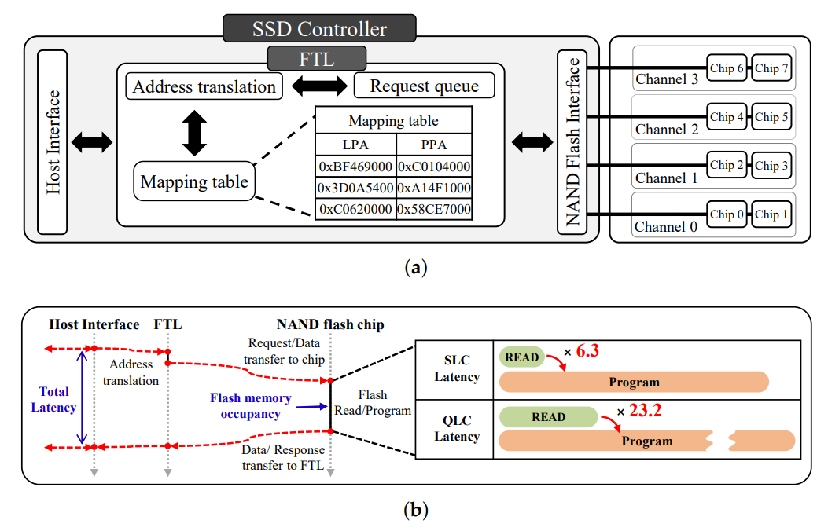
Abstract(2/2)

Slide 5
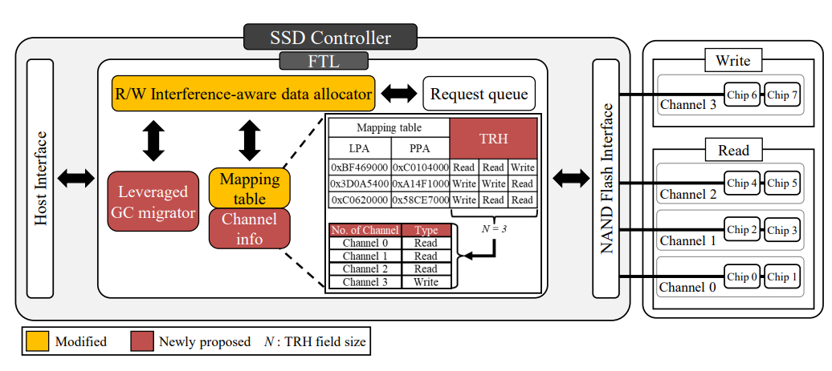
Parallelism-Aware-Channel-Partition (PACP)
The goal of PACP is to increase the flash memory resource utilization and mitigate R/W interference through workload-aware page allocation.

Slide 6
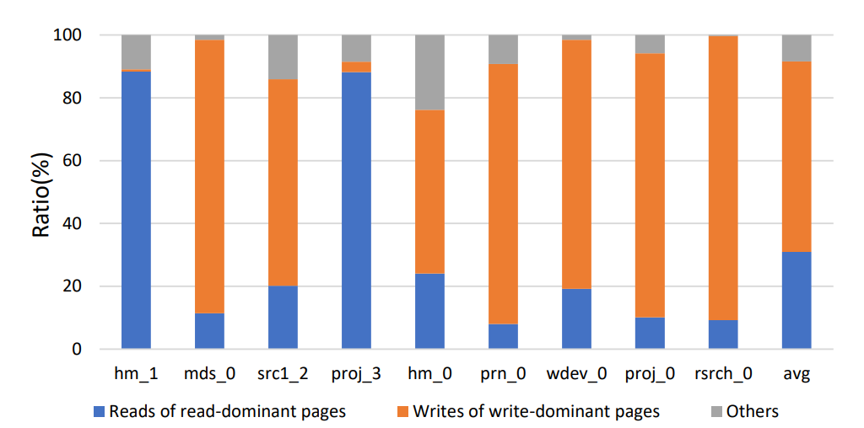
PACP: Request Prediction on Page(1/2)
A page is classified as read-dominant (write-dominant) if more than 90% of the requests processed are read (write). Otherwise, it is categorized as a mixed page.
Data from Microsoft Research

Slide 7
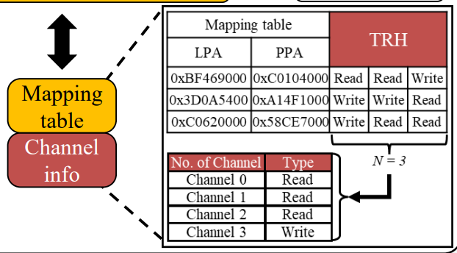
PACP: Request Prediction on Page(2/2)
TRH records the request type and TRH field can track N recent requests.
The predicted type is determined by comparing the number of reads and writes in the TRH; the greater one is chosen.
To deal with an even number of transaction histories are held, the request is predicted based on the stored channel information to utilize the evicted past access information.

Slide 8
PACP: R/W-Interference-Aware Page Allocation(1/3)
PACP aims to minimize R/W interference by isolating the flash memory resource for read and write while taking parallelism into account.
The channel partition ratio is dynamically adjusted by channel information in TRH, effectively responding to request intensity and maximizing resource utilization.

Slide 9

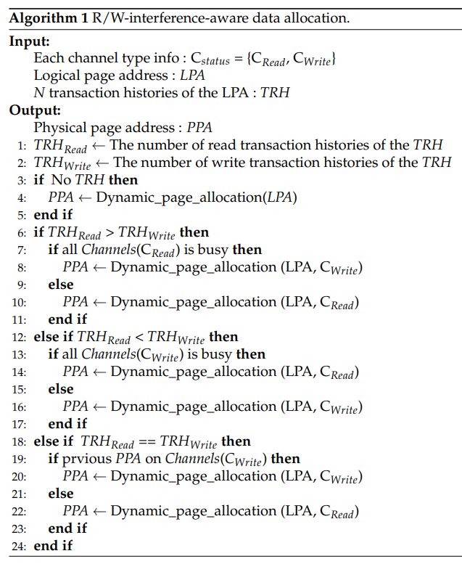
PACP: R/W-Interference-Aware Page Allocation(2/3)

Slide 10
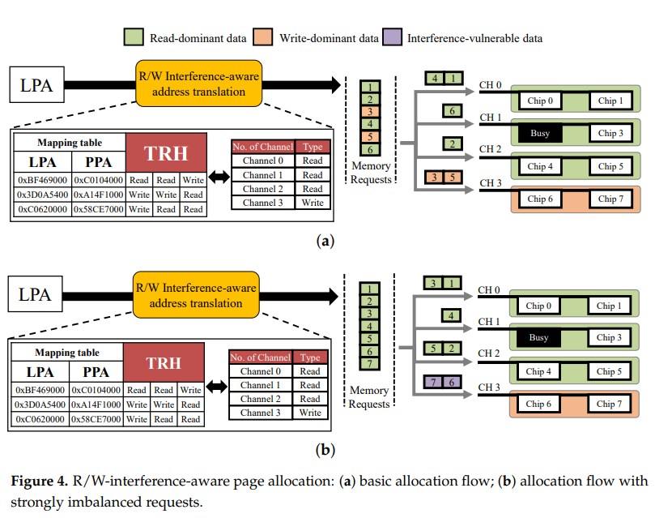
PACP: R/W-Interference-Aware Page Allocation(3/3)

Slide 11
PACP: Leveraged GC migration
Background Migration: Only be performed when the storage system is not in use due to performance degradation caused by migrations.
GC-aware migration: The block with the largest number of invalid pages is chosen to increase the efficiency of GC that will occur and reallocate page that is vulnerable to interference.

Slide 12
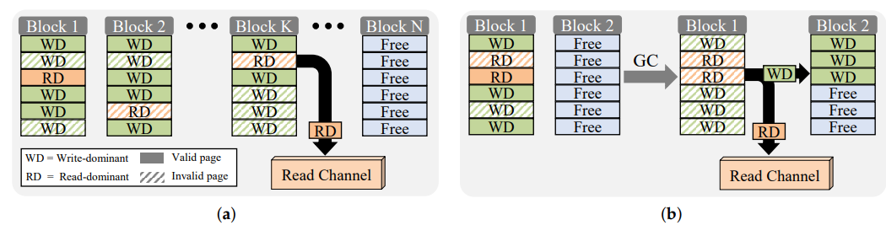
PACP: Leveraged GC migration
Background Migration
GC Migration

Slide 13
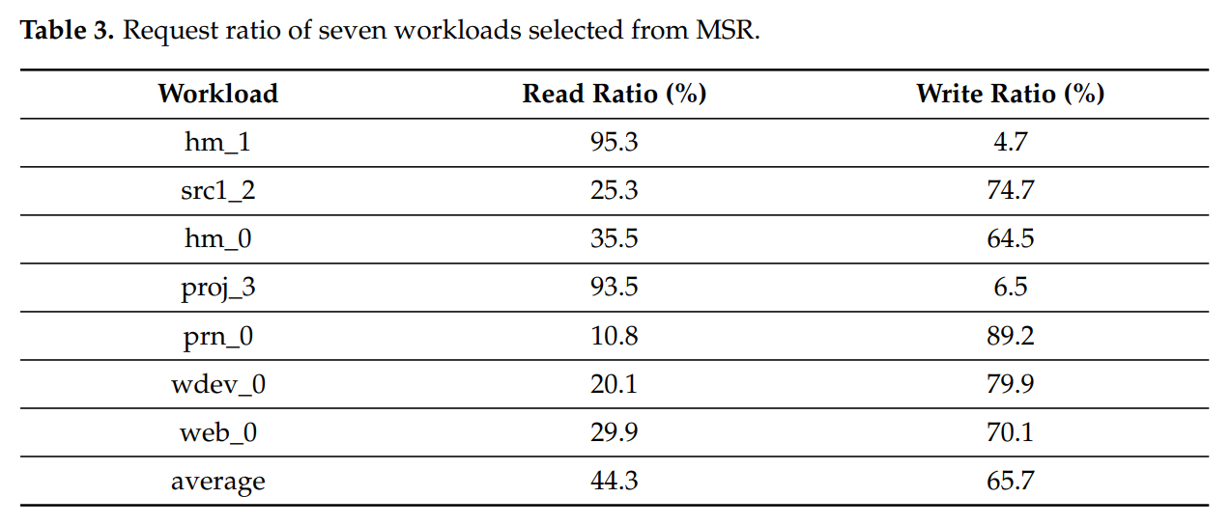
Evaluation

Slide 14
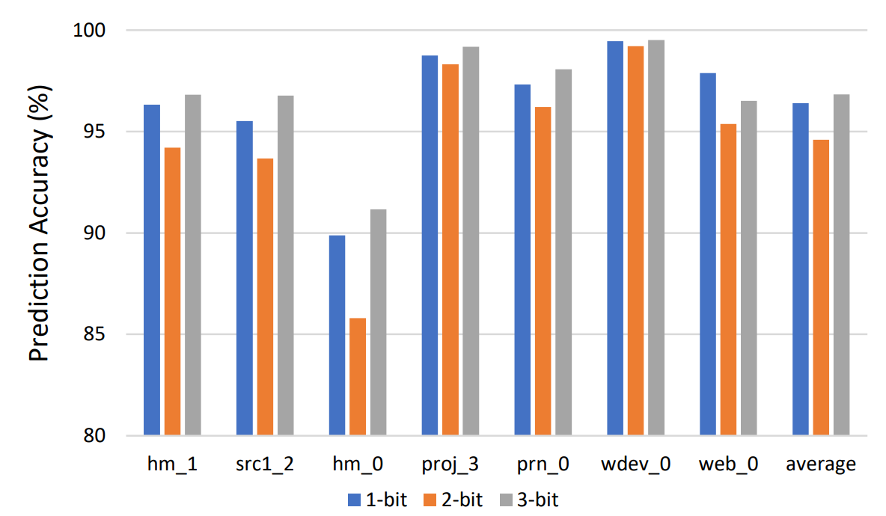
Evaluation: Prediction Accuracy Based on TRH
an additional bit = 2MB capacity overhead
SSD needs to upgrade 0.1% capacity
96.4
94.6
96.9

Slide 15
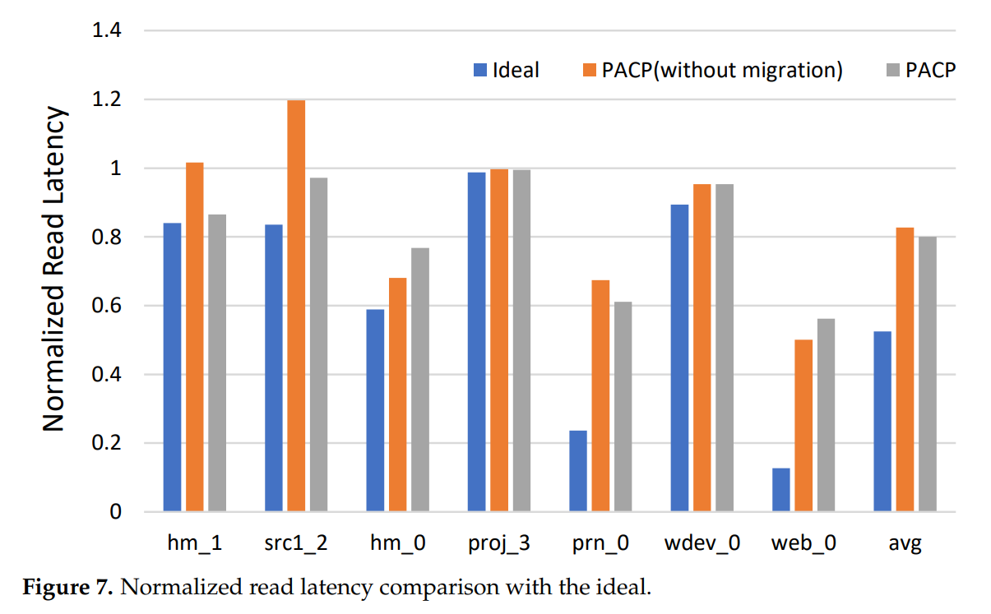
Evaluation: Read Latency(1/2)

Slide 16
Evaluation: Read Latency(2/2)
Closer to ideal latency

Slide 17
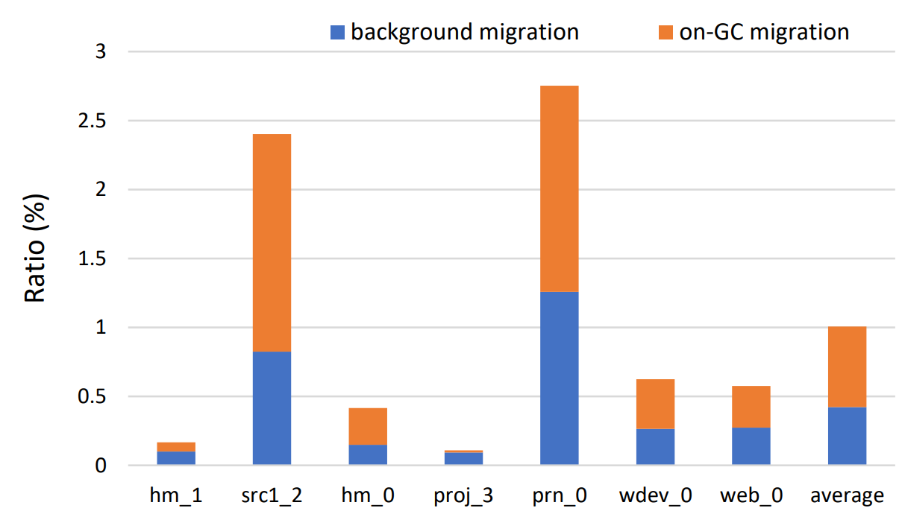
Evaluation: Migration Ratio(1/3)

Slide 18
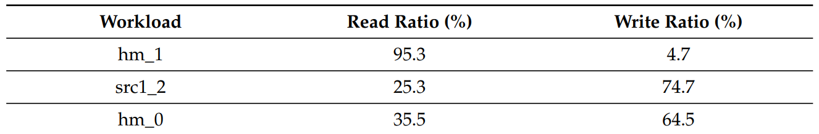
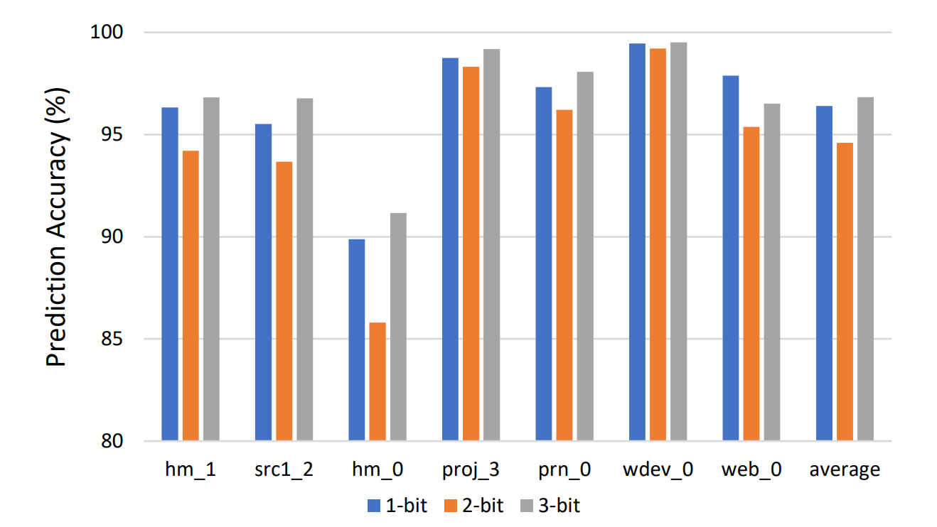
Evaluation: Migration Ratio(2/3)
Mixed Request
Low Accuracy

Slide 19
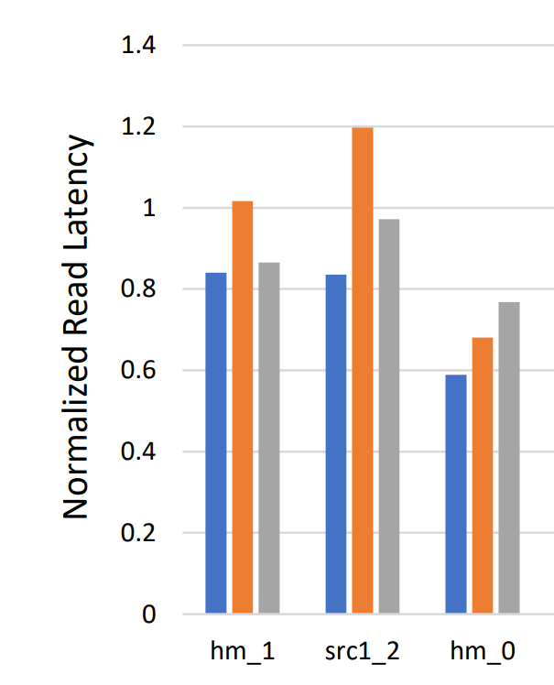
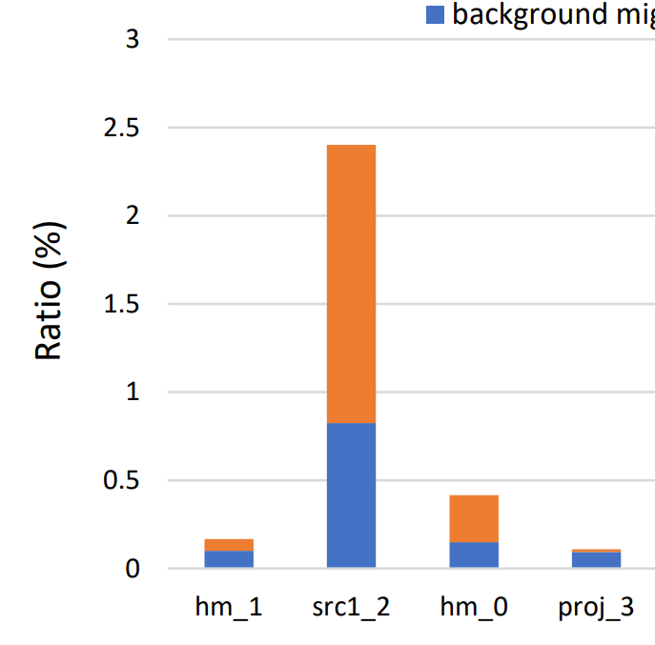
Evaluation: Migration Ratio(3/3)
Low Ratio of Migration
Overhead raise the latency

Slide 20
Conclusion
This paper proposed a PACP technique that exploits the request access pattern to mitigate R/W interference and increase parallel flash-memory resource utilization.
To improve its lifespan problem that mentioned above, the future work of PACP includes a wear leveling method for dynamically updated, partitioned SSD.
Student question: What if lower the dominancy-rate to 80%, 70%, or 60% in TRH? Would it increase the accuracy? Would it improve or degrade the performance?

